Slide 1
2021 SALARY SURVEY
Data Cleaning & Insight Findings
From a messy 28,000+ response survey to reliable insights on pay

Slide 2
Project Overview
Goal
RESEARCH QUESTIONS ANSWERED
Clean a messy, real-world salary survey dataset and turn it into reliable insights through exploratory data analysis and visualization.
1
Does more experience mean more money, and by how much per year?
Dataset
2
Is a Master's/PhD worth it in dollar terms?
28,225 raw survey responses (AskAManager.org, 2021), 18 original columns — mostly long Google Form question text.
3
Which industries pay the best?
4
Does location change what you get paid?
5
Which job titles pay the most, and how consistent is pay within a title?
2021 Salary Survey — Key Points
2

Slide 3
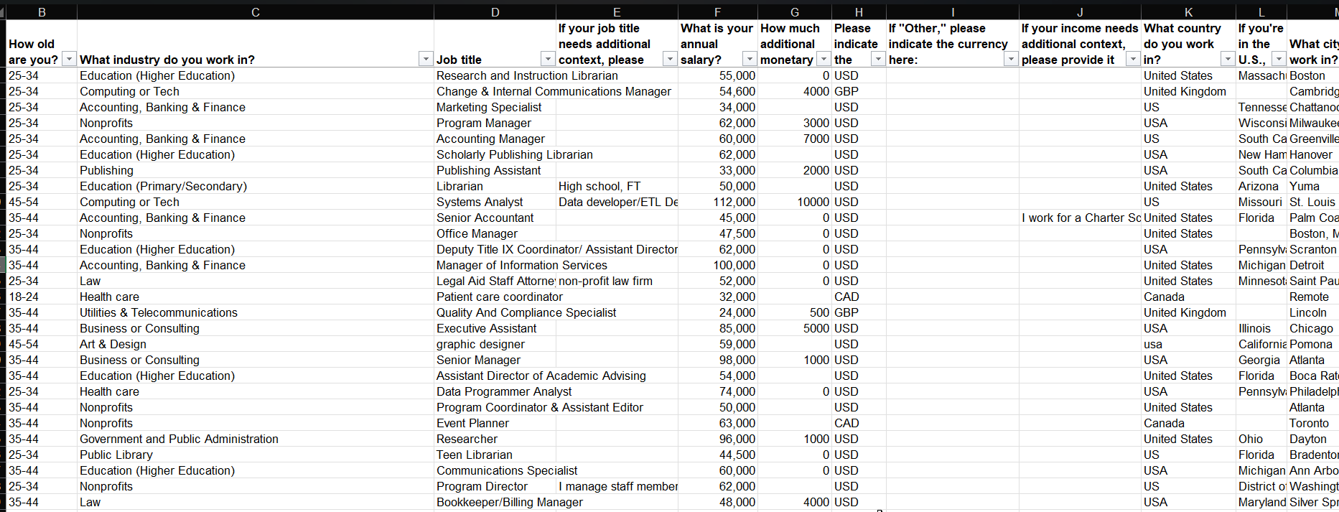
Raw Dataset Overview

Slide 4
Data Cleaning Highlights
EXAMPLE RAW COLUMN NAME
“What is your annual salary? (You'll indicate the currency in a later question. If you are part-time or hourly, please enter an annualized equivalent — what you would earn if you worked the job 40 hours a week, 52 weeks a year.)”
Columns:
9 of 18 raw columns removed (metadata, redundant, or out-of-scope free text); the 9 kept were renamed from long question text to short field names.
Free-text standardization:
→ renamed to: annual_salary
OUTLIER HANDLING
Salaries outside the $10,000–$2,000,000 range were flagged using a fixed rule, instead of a statistical one that could misfire on skewed income data.
Field | Before | After
industry | 1,225 unique values | 24 categories
job_title | 14,434 unique values | 41 categories
country | 363 unique values | 11 categories
208 rows removed (0.74%)
Salary field stored as text with commas (“55,000”) — converted to numeric.
Currency: dropped the ~0.6% of rows with Other/unspecified currency — no reliable value to compare.
Missing data handled deliberately: education & gender nulls (<1%) labeled “Not Specified,” not imputed — avoids fabricating demographic data.
FINAL ANALYSIS-READY DATASET
27,841 rows × 9 columns
Fully typed (categoricals, ordered categoricals for age & experience) — zero remaining nulls.
2021 Salary Survey — Key Points
3

Slide 5
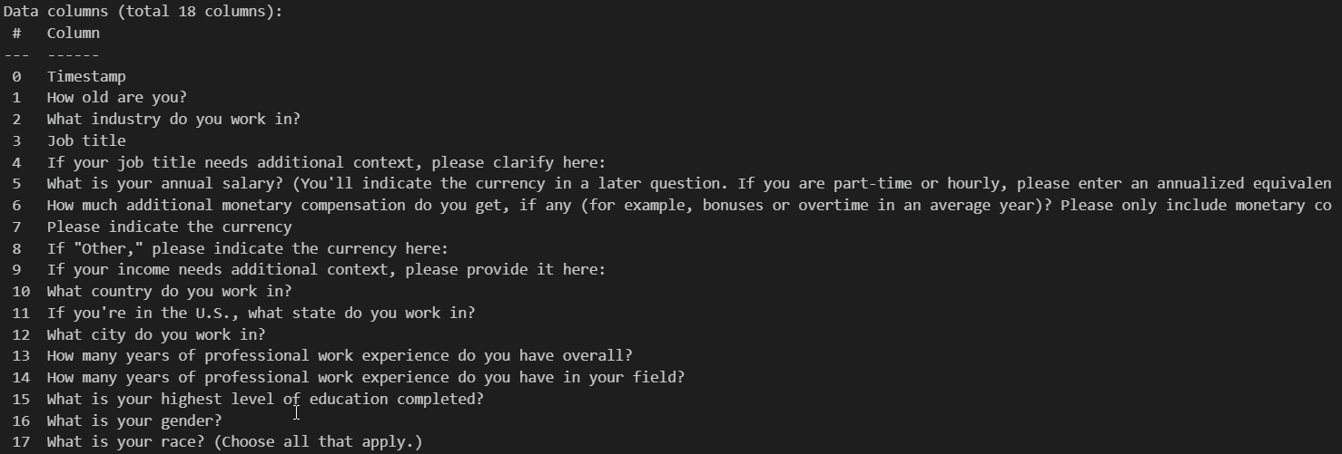
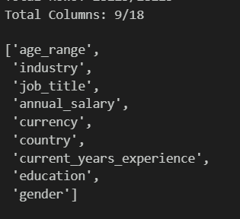
Data Raw Columns
After Data Cleaning

Slide 6
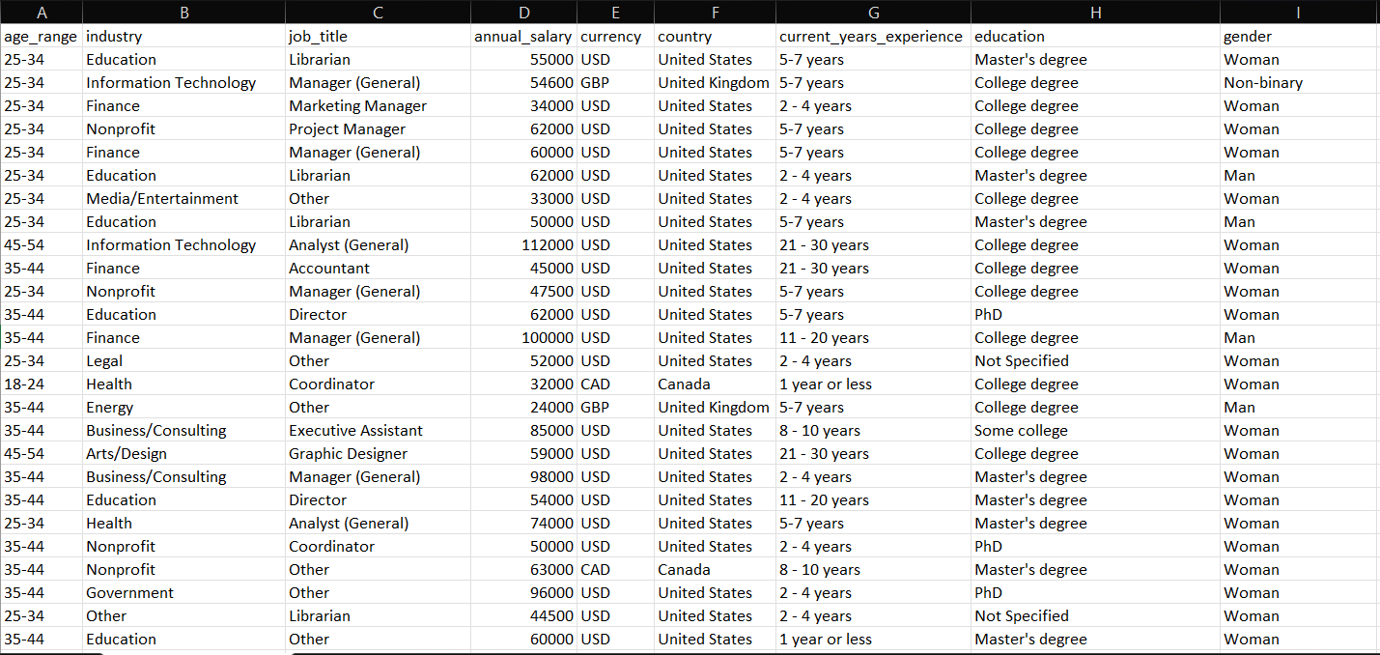
Cleaned Dataset

Slide 7
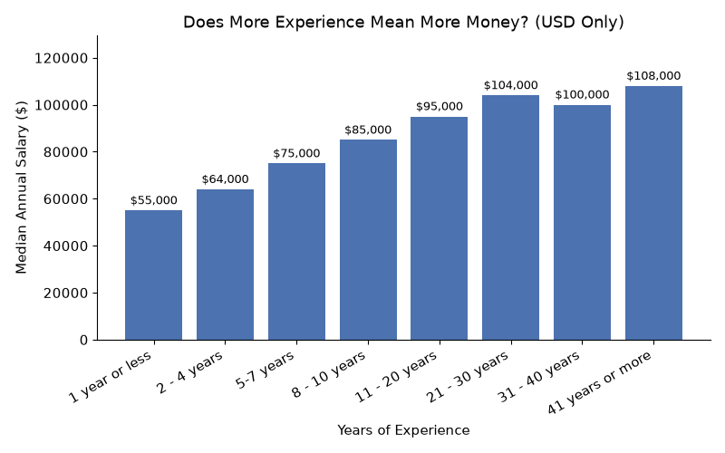
1
Experience → Salary
Yes, more experience means more money.
Median salary rises from $55,000 (1 year or less) to $104,000 (21-30 years).
Pay grows fastest in the first 10-20 years, then levels off, dipping slightly at 31-40 years ($100,000) before ticking back up at 41+ years ($108,000).
TAKEAWAY
More experience means more pay, but only up to a point, then it levels off.
2021 Salary Survey — Key Points
4

Slide 8
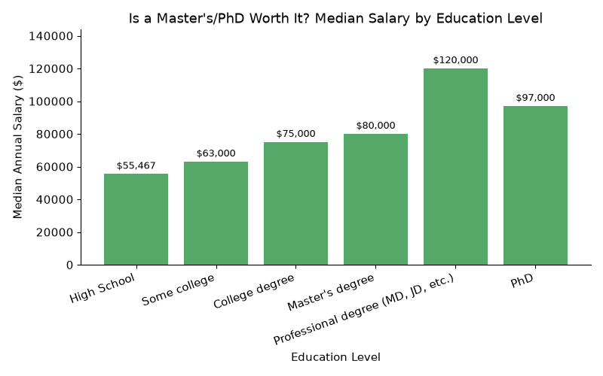
2
Education → Salary
A Master's degree is worth more, but the gap is modest.
Summary:
Median salary rises with education, from $55,467 (High School) to $120,000 (Professional degree). The biggest jump is College → Professional degree (+$45,000). PhD ($97,000) actually earns less than Professional degree ($120,000).
CAVEAT
Individual salaries overlap heavily across education levels — a degree alone doesn't guarantee higher pay.
2021 Salary Survey — Key Points
5

Slide 9
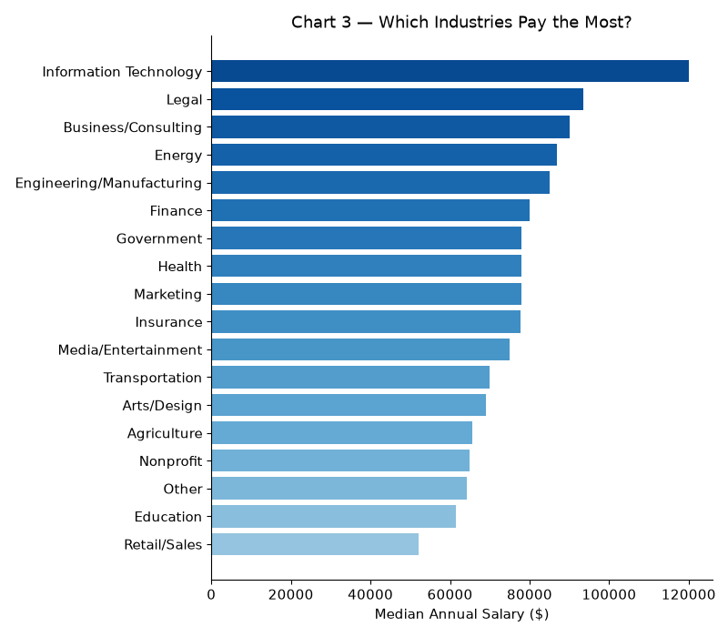
3
Industry → Salary
Pay varies sharply by industry (≥100 responses each).
$112,500
Information Technology — highest paying
$49,000
Retail/Sales — lowest paying
Other notable: Legal ($90,000), Business/Consulting ($88,000), Engineering/Manufacturing ($83,500).
TAKEAWAY
Pay clearly depends on industry — IT tops the list, Retail/Sales is lowest.
2021 Salary Survey — Key Points
6

Slide 10
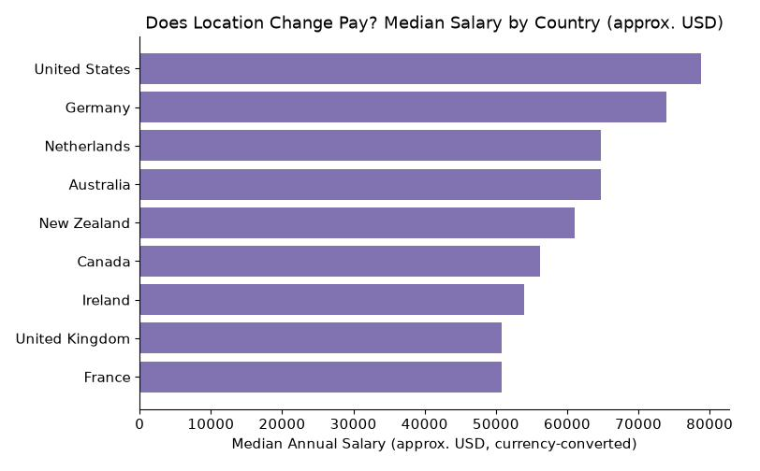
4
Location → Salary
Yes — but the comparison comes with caveats.
$78,800
United States — highest approx. median pay
$50,760
France — lowest approx. median pay
CAVEAT
83% of all responses are from the US, so non-US medians rest on much smaller samples. Currency conversion used fixed, approximate rates — not adjusted for cost of living.
2021 Salary Survey — Key Points
7

Slide 11
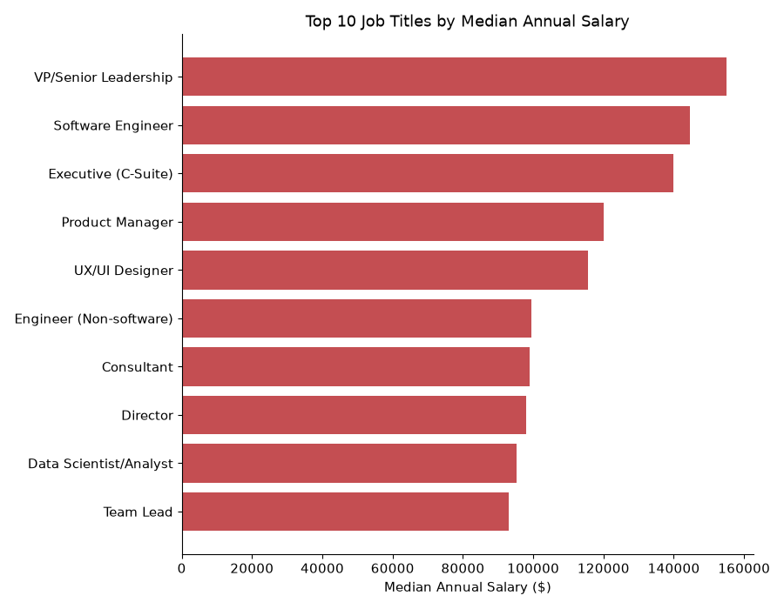
5
Job Title → Pay Level vs. Consistency
Title indicates the ballpark, not the exact number.
HIGHEST MEDIAN PAY
VP/Senior Leadership ($152,000), Software Engineer ($135,600), Executive C-Suite ($135,000)
MOST CONSISTENT (NARROW SPREAD)
Administrative Assistant, Customer Service, Coordinator — lower pay, but tightly clustered.
LEAST CONSISTENT (WIDE SPREAD)
Executive (C-Suite), VP/Senior Leadership — high pay on average, but wide person-to-person variation.
TAKEAWAY
Job title indicates the ballpark, not the exact number — especially at senior levels.
2021 Salary Survey — Key Points
8

Slide 12
Summary of Findings
Experience
Steady growth, plateaus after ~20 years.
Education
Master's/PhD pays more, but overlap between levels is significant.
Industry
Clear pay gap — IT tops the list, Retail/Sales is lowest.
Location
Pay differs by country, but data is US-dominated and not cost-of-living adjusted.
Job Title
Predicts pay level but not consistency — some titles vary widely.
2021 Salary Survey — Key Points
9

Slide 13
Limitations to Mention
Self-reported survey data — no way to verify accuracy.
!
Heavily US-skewed sample (~83% of responses).
!
Currency conversion for country comparison is approximate, not cost-of-living adjusted.
!
Free-text fields (industry, job title, country) required keyword-based categorization, which may misclassify edge cases.
!
2021 Salary Survey — Key Points
10

